Slide 1
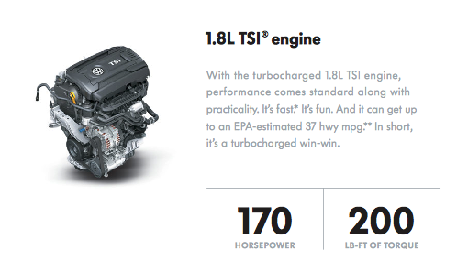
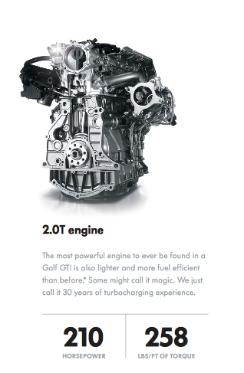
Improving Model Performance Lantz Ch 11
Wk 6, Part 1
Above, left – The basic 1.8 liter engine offered for 2015 in the ageless VW Golf is way more powerful than the 90 hp of the original, 1974 “Rabbit.” But, right, higher performance is dangled before the buyer in such forms as the GTI’s 2.0 liter engine.
Notes:
Image from http://statistical-research.com/spatial-clustering-with-equal-sizes/

Slide 2
Reasons to go for it
The cost of spending more time perfecting an algorithm is much less than the cost of bad performance in production use of the algorithm.
The performance of the existing algorithm is unacceptable, like:
Says some poisonous mushrooms are edible, or
Misses half of the loan applicants who will default.

Slide 3
Let’s use those loans as an example:
In Ch 5, we used a “stock C5.0” decision tree to build the classifier for this credit data.
We attempted to improve its performance by adjusting the trials parameter to increase the number of boosting iterations.
This increased the model’s accuracy.
Called “parameter tuning.”

Slide 4
A general idea…
Could use parameter tuning for things other than decision trees.
We tuned the k-nearest neighbor models, searching for the best value of k.
We used a number of options for neural networks and SVMs:
Like adjusting the number of nodes, hidden layers
Choosing a different kernel function.

Slide 5
Typically,
Most machine learning algorithms allow you to adjust at least one parameter.
Some let you tune a lot of these.
Could lead to guessing the tuning values.
What’s a general approach to this?

Slide 6
Caret
We used the caret package in Ch 10.
It has tools to assist in automated tuning.
Need to ask 3 questions:
What type of machine learning model should be trained on the data?
150 to choose from – see http://topepo.github.io/caret/modelList.html and →
Which model parameters can be adjusted, and how extensively should they be tuned?
What criteria should be used to evaluate the models to find the best candidate?

Slide 7
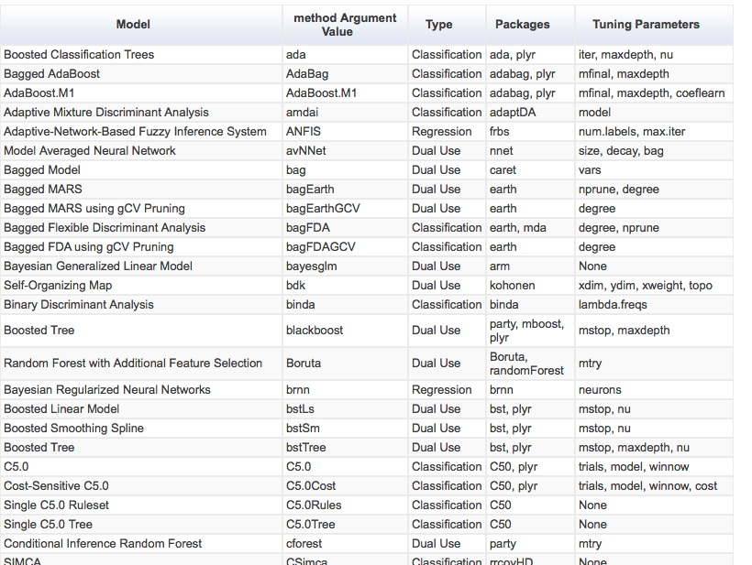

Slide 8
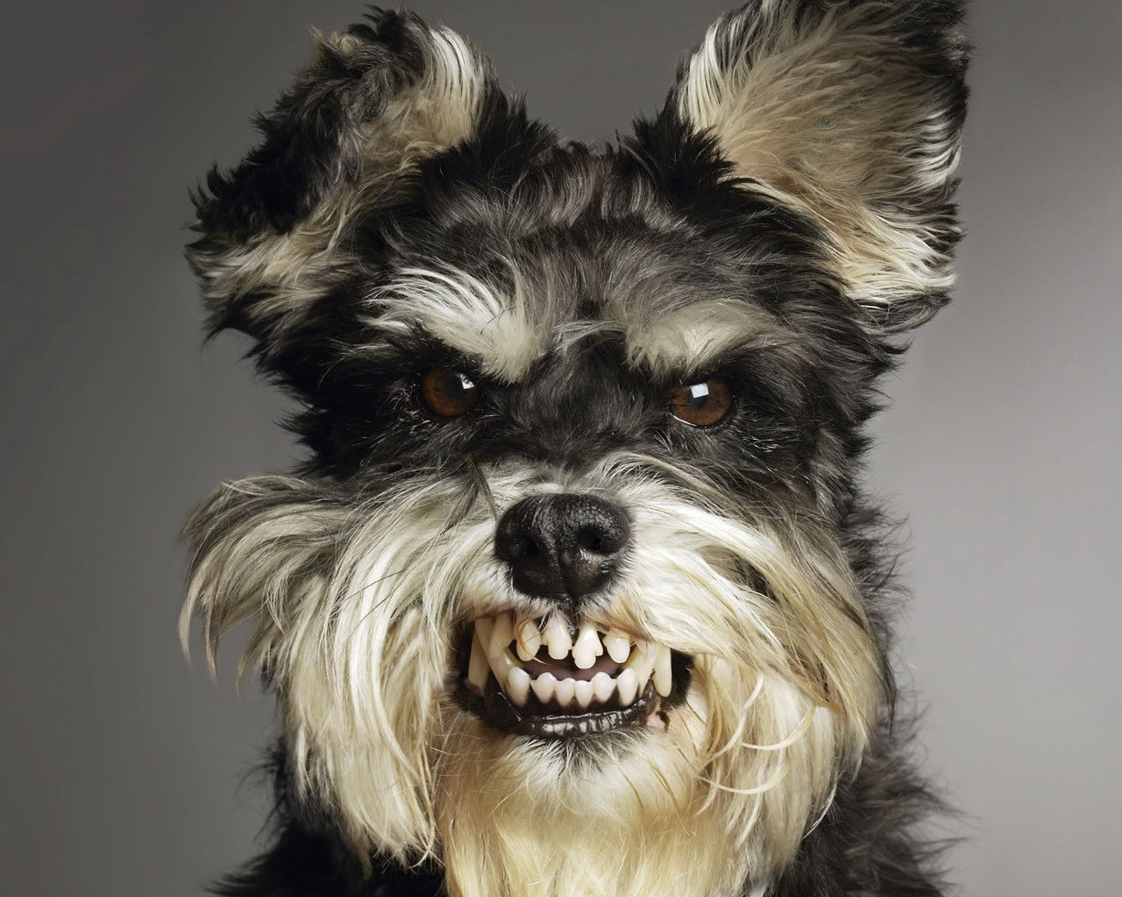
Let’s sic caret on those credit scores
> library(caret)
Loading required package: lattice
Loading required package: ggplot2
Warning message:
package ‘caret’ was built under R version 3.1.2
> set.seed(300)
> m <- train(default ~ ., data = credit, method = "C5.0")
Loading required package: C50
Loading required package: plyr
There were 50 or more warnings (use warnings() to see the first 50)
Notes:
Image from http://www.sellingpoint.ch/2013/04/11/how-to-appease-angry-customers/

Slide 9
Results of first tuning try
> m
C5.0
1000 samples
16 predictor
2 classes: 'no', 'yes'
No pre-processing
Resampling: Bootstrapped (25 reps)
Summary of sample sizes: 1000, 1000, 1000, 1000, 1000, 1000, ...
Resampling results across tuning parameters:
model winnow trials Accuracy Kappa Accuracy SD Kappa SD
rules FALSE 1 0.6847204 0.2578421 0.02558775 0.05622302
rules FALSE 10 0.7112829 0.3094601 0.02087257 0.04585890
rules FALSE 20 0.7221976 0.3260145 0.01977334 0.04512083
rules TRUE 1 0.6888432 0.2549192 0.02683844 0.05695277
rules TRUE 10 0.7113716 0.3038075 0.01947701 0.04484956
rules TRUE 20 0.7233222 0.3266866 0.01843672 0.03714053
tree FALSE 1 0.6769653 0.2285102 0.03027647 0.07001131
tree FALSE 10 0.7222552 0.2880662 0.02061900 0.05601918
tree FALSE 20 0.7297858 0.3067404 0.02007556 0.05616826
tree TRUE 1 0.6771020 0.2219533 0.02703456 0.05955907
tree TRUE 10 0.7173312 0.2777136 0.01700633 0.04358591
tree TRUE 20 0.7285714 0.3058474 0.01497973 0.04145128
Accuracy was used to select the optimal model using the largest value.
The final values used for the model were trials = 20, model = tree
and winnow = FALSE.
Building decision trees from all 1000 samples, but taking them in different random orders.

Slide 10
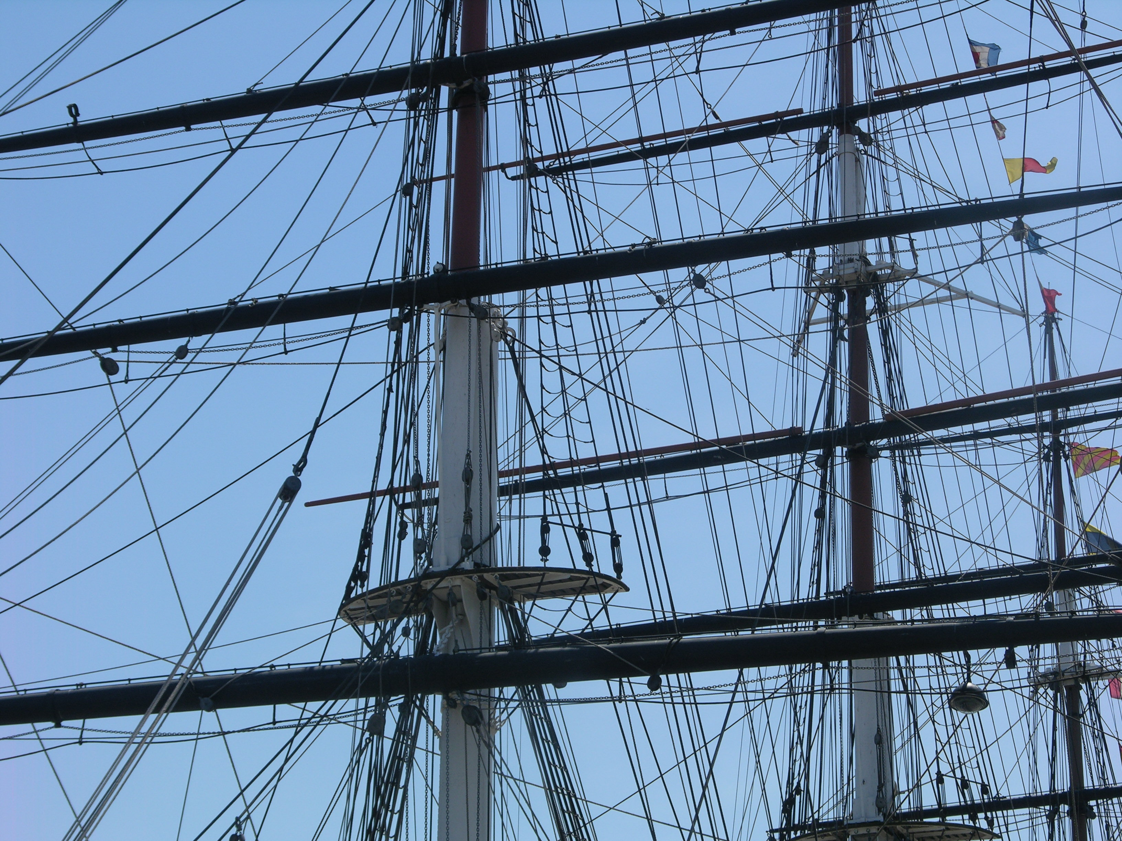
Best results… rigged
> p <- predict(m, credit)
> table(p, credit$default)
p no yes
no 700 2
yes 0 298
> head(predict(m, credit))
[1] no yes no no yes no
Levels: no yes
> head(predict(m, credit, type = "prob"))
no yes
1 0.9606970 0.03930299
2 0.1388444 0.86115561
3 1.0000000 0.00000000
4 0.7720279 0.22797208
5 0.2948062 0.70519385
6 0.8583715 0.14162851
We also trained on this data, so it’s just “resubstitution error.”
The .73 Accuracy is closer to “how well it works on test data.”
Notes:
Cutty Sark rigging from http://commons.wikimedia.org/wiki/File:Cutty_Sark_rigging.jpg

Slide 11
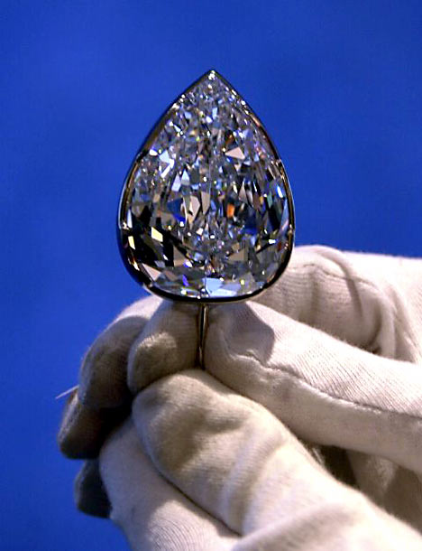
Doing better with caret
Use kappa to optimize a boost parameter.
The trainControl() function creates configuration options – a “control object” to use with the train() function.
Defines resampling strategy like
Holdout sampling, or
K-fold cross-validation;
and
Measure used to choose the best model.
Notes:
Image of 203 carat Millennium Star diamond from http://thatluxurylife.blogspot.com/2010/06/biggest-diamonds-in-world.html

Slide 12
On the credit scores
> ctrl <- trainControl(method = "cv", number = 10, selectionFunction = "oneSE")
> grid <- expand.grid(.model = "tree",
+ .trials = c(1, 5, 10, 15, 20, 35, 30, 35),
+ .winnow = "FALSE")
> grid
.model .trials .winnow
1 tree 1 FALSE
2 tree 5 FALSE
3 tree 10 FALSE
4 tree 15 FALSE
5 tree 20 FALSE
6 tree 35 FALSE
7 tree 30 FALSE
8 tree 35 FALSE
Each row creates a candidate model

Slide 13
Here’s the training
The winner, using oneSE
> set.seed(300)
> m <- train(default ~ ., data = credit, method = "C5.0",
+ metric = "Kappa", trControl = ctrl, tuneGrid = grid)
Warning message:
In Ops.factor(x$winnow) : ! not meaningful for factors
> m
C5.0
1000 samples
16 predictor
2 classes: 'no', 'yes'
No pre-processing
Resampling: Cross-Validated (10 fold)
Summary of sample sizes: 900, 900, 900, 900, 900, 900, ...
Resampling results across tuning parameters:
trials Accuracy Kappa Accuracy SD Kappa SD
1 0.724 0.3124461 0.02547330 0.05897140
5 0.713 0.2921760 0.02110819 0.06018851
10 0.719 0.2947271 0.03107339 0.06719720
15 0.721 0.3009258 0.01969207 0.05105480
20 0.717 0.2929875 0.02790858 0.07912362
30 0.729 0.3104144 0.02766867 0.08069045
35 0.741 0.3389908 0.03142893 0.09352673
Tuning parameter 'model' was held constant at a value of tree
Tuning parameter 'winnow' was held constant at a value of FALSE
Kappa was used to select the optimal model using the one SE rule.
The final values used for the model were trials = 1, model = tree
and winnow = FALSE.

Slide 14
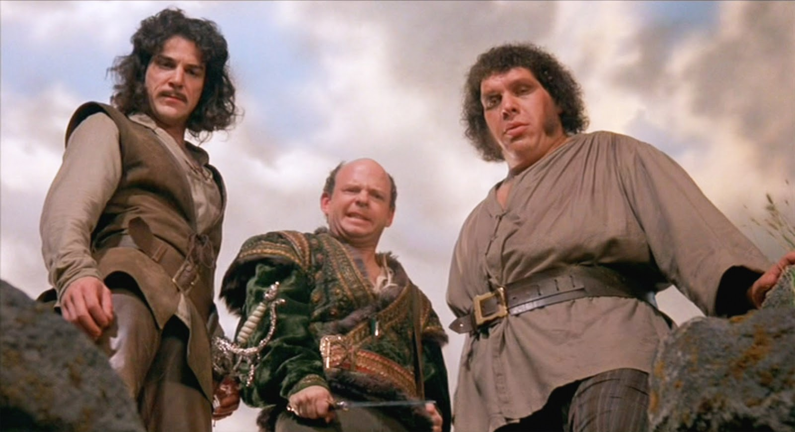
How about some meta-learning?
Combine multiple models
Complementary strengths
Could see this as learning how to learn
Notes:
Image of 3 complementary villains from movie, “The Princess Bride,” from http://www.scriptmag.com/features/specs-city-threshold-guardian-archetype-princess-bride

Slide 15
Create a learning “ensemble”
Out of multiple weak learners → a strong learner
Have to answer 2 questions:
How are the weak learning models chosen and/or constructed?
How are the weak learners’ predictions combined to make a single final prediction?

Slide 16
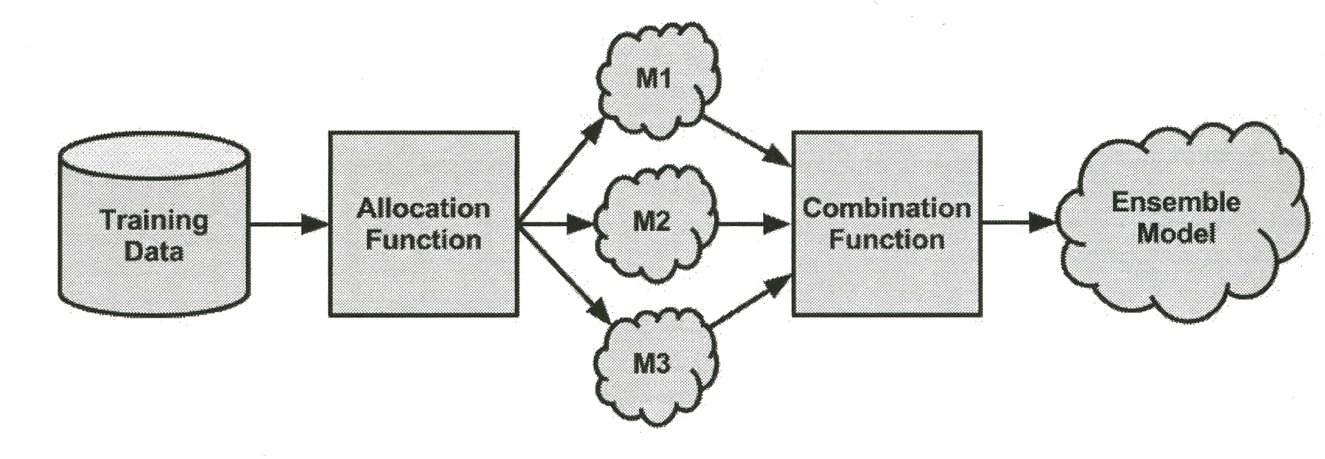
Or,
Also known as Stacking
Notes:
Lantz, p 338

Slide 17
Advantages of ensembles
Spend less time in pursuit of a single best model.
Better generalizability to future problems.
Improved performance on massive or miniscule datasets.
The ability to synthesize data from distinct domains.
The more nuanced understanding of difficult learning tasks.
Notes:
Lantz p 339

Slide 18
One type of ensemble - Bagging
Also called Bootstrap aggregating.
Generates a number of training datasets by bootstrap sampling.
These generate a set of models using a single learning algorithm.
Their predictions are combined via:
Voting (for classification), or
Averaging (for numeric prediction).

Slide 19
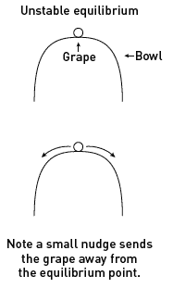
Good for…
Unstable learners that
Change substantially with slight data changes.
These are more diverse.
So, often used with decision trees.
Notes:
Unstable physical situation, from http://www.learner.org/courses/mathilluminated/units/13/textbook/03.php.

Slide 20
Credit – create & test the ensemble:
> library(ipred)
> set.seed(300)
> mybag <- bagging(default ~ ., data = credit, nbagg = 25)
> credit_pred <- predict(mybag, credit)
> table(credit_pred, credit$default)
credit_pred no yes
no 699 2
yes 1 298

Slide 21
How well does it really work?
> set.seed(300)
> ctrl <- trainControl(method = "cv", number = 10)
> train(default ~ ., data = credit, method = "treebag", trControl = ctrl)
Bagged CART
1000 samples
16 predictor
2 classes: 'no', 'yes'
No pre-processing
Resampling: Cross-Validated (10 fold)
Summary of sample sizes: 900, 900, 900, 900, 900, 900, ...
Resampling results
Accuracy Kappa Accuracy SD Kappa SD
0.735 0.3297726 0.03439961 0.08590462
On a par with the best-tuned C5.0 decision tree.

Slide 22
Beyond bags of decision trees
Caret lets you do more general bag() functions.
E.g.,
> str(svmBag)
List of 3
$ fit :function (x, y, ...)
$ pred :function (object, x)
$ aggregate:function (x, type = "class")
Make bags of SVM/s.

Slide 23
Using SVM bag on credit example:
> set.seed(300)
> svmbag <- train(default ~ ., data = credit, "bag", trControl = ctrl, bagControl = bagctrl)
Using automatic sigma estimation (sigest) for RBF or laplace kernel
Using automatic sigma estimation (sigest) for RBF or laplace kernel
…
> svmbag
Bagged Model
1000 samples
16 predictor
2 classes: 'no', 'yes'
No pre-processing
Resampling: Cross-Validated (10 fold)
Summary of sample sizes: 900, 900, 900, 900, 900, 900, ...
Resampling results
Accuracy Kappa Accuracy SD Kappa SD
0.728 0.2929505 0.04442222 0.1318101
Tuning parameter 'vars' was held constant at a value of 35
Not as good as bagged decision tree model.

Slide 24
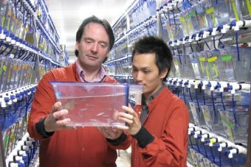
Boosting
Given a number of classifiers,
Each with error rate less than 50%,
You can increase performance by combining,
Often to an arbitrary threshold,
By adding more weak learners.
Like stem cells, this is a significant discovery!
Notes:
Image from http://www.abc.net.au/news/2014-08-14/zebrafish-study-leads-to-surprising-stem-cell-discovery/5670940

Slide 25
What’s different here?
In boosting,
The resampled datasets are constructed specifically to generate complementary learners.
The vote is weighted based on each model’s performance,
Versus each getting an equal vote.

Slide 26
How boosting works
Start with an unweighted dataset
The first classifier attempts to model the outcome.
Examples it got right are less likely to appear in the dataset for the following classifier.
Examples it got wrong are more likely to appear.
So, succeeding rounds of learners are trained on data with successively more difficult examples.
Continue till the desired overall error rate is reached, or
Until performance no longer improves.

Slide 27
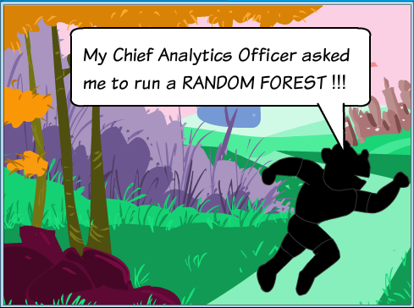
Random forests are
Ensembles of decision trees.
Combines bagging with random feature selection.
Adds diversity to the decision tree models.
After the forest is generated, the model uses a vote to combine the trees’ predictions.
Notes:
Cartoon from http://analyticsindiamag.com/random-forest/

Slide 28
Random forests:
Strengths | Weaknesses
An all-purpose model that performs well on most problems. | Unlike a decision tree, the model is not easily interpretable.
Can handle noisy or missing data; categorical or continuous features. | May require some work to tune the model to the data.
Selects only the most important features.
Can be used on data with an extremely large number of features or examples.

Slide 29
Training
> library(randomForest)
randomForest 4.6-10
Type rfNews() to see new features/changes/bug fixes.
> set.seed(300)
> rf <- randomForest(default ~ ., data = credit)
> rf
Call:
randomForest(formula = default ~ ., data = credit)
Type of random forest: classification
Number of trees: 500
No. of variables tried at each split: 4
OOB estimate of error rate: 23.8%
Confusion matrix:
no yes class.error
no 640 60 0.08571429
yes 178 122 0.59333333
A decent estimate of future performance.

Slide 30
Evaluating performance
> ctrl <- trainControl(method = "repeatedcv", number = 10, repeats = 10)
> grid_rf <- expand.grid(.mtry = c(2, 4, 8, 16))
> set.seed(300)
> m_rf <- train(default ~ ., data = credit, method = rf",
+ metric = "Kappa", trControl = ctrl,
+ tuneGrid = grid_rf)
This takes a while to run!
End result – similar to boosted tree.

